Slide 1
STEPS:
Fetch historical data for many stocks from the FMP API
Store this data locally in a traditional relational database (in prod we can use Postgres)
Clean and enrich the data (here we can maybe using Airflow, but I don’t think it is necessary)
Push this data into a Graph Database (Neo4j - for local database or Neo4jAura - for Cloud database)
Data flows from Graph database via Agent to the User
User makes prompts to the Agent/Chatbot
Agent generates answers using data from the Graph Database
Agent then returns answers to the User
NOTES
Frontend will be a chatbot (or whatever) likely written in Next.js and Typescript
Backend code is 100% Python (including the AI frameworks like Langchain, Huggingface, etc.)
Databases: Postgres and Graph Database

Slide 2
FMP DATA
Each Tool is given:
- Set of instructions what to do
- Access to LLM (GPT4o/mini)
Prompt 1: Suggest 10 companies with high return…
Prompt 2: Special: Suggest 10 companies in a specific field
Prompt 3: Make Index
Prompt 4: Hello
Data Transformation
Graph Tool
Langchain
GraphCypherQAChain
(LLM)
Cypher Query →
← List of Tickers
Agent Executor is given:
- Set of instructions what to do
- Access to LLM (GPT4o/mini)
Neo4j Aura Graph Database
User Query →
← List of Tickers
(Communication
via port 800/index-rag-agent)
Streamlit UI
Port 8501
Langchain
Agent Executor
(LLM)
Special Tool
Langchain
RetrievalQA
(LLM)
User Query (embedded) →
← List of Tickers
Stock Info
Stock Prices
Stock Mcaps
(Relational Database)
Complete Data →
← List of Tickers
Maintain Conversation
List of Tickers →
← Prices and Mcaps
for each ticker
Backtesting Function for calculating historical index performance
Make Index Tool
(LLM)
Stock Info
Stock Prices
Stock Mcaps
(Relational Database)
No Tool

Slide 3
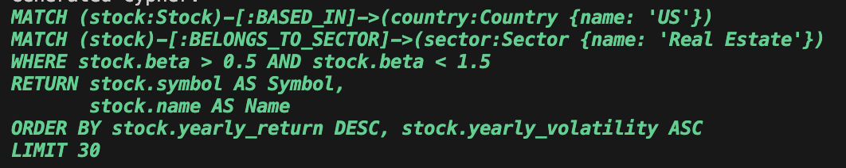
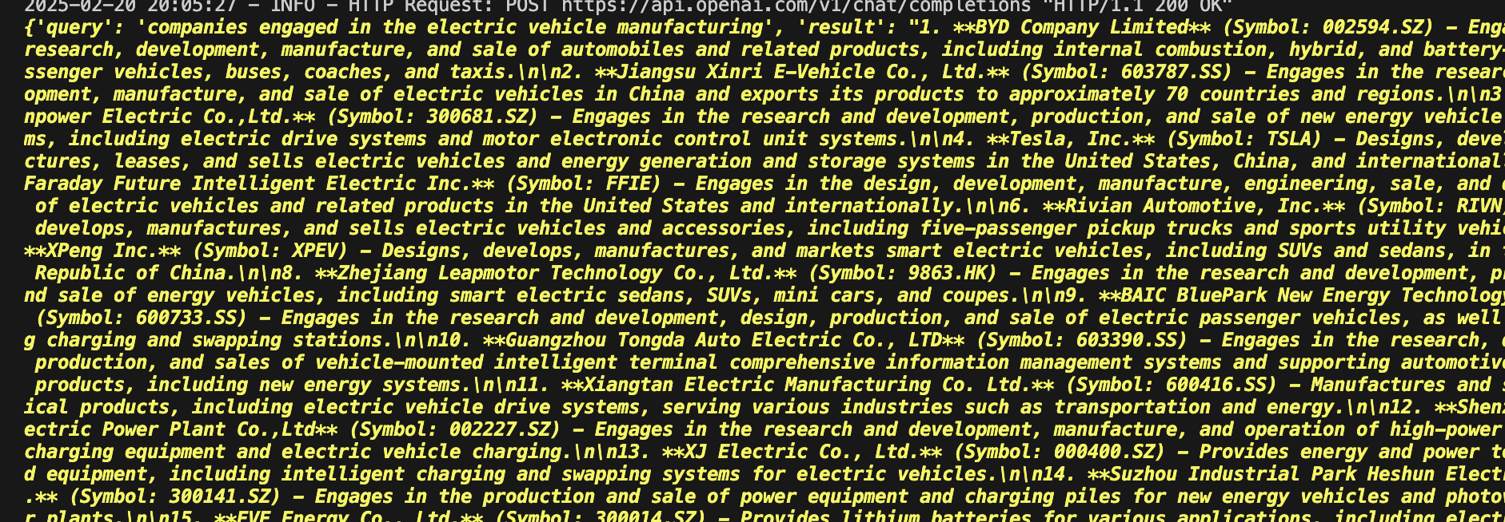
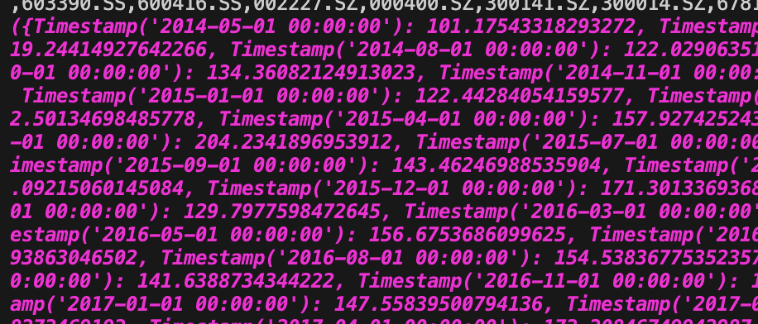
FMP DATA
Every Tool is given:
- Set of instructions what to do
- Access to LLM (GPT4o/mini)
Neo4j Aura Graph Database
Graph Tool
Langchain
GraphCypherQAChain
(LLM)
Prompt 1: Suggest 10 companies with high return…
Prompt 2: Special: Suggest 10 companies in a specific field
Prompt 3: Make Index
Prompt 4: Hello
Agent is given:
- Set of instructions what to do
- Access to LLM (GPT4o/mini)
FMP DATA
Embedded prompt
Streamlit UI
Port 8501
Port 800/index-rag-agent
Langchain
Agent Executor
(LLM)
Special Tool
Langchain
RetrievalQA
(LLM)
Neo4j Aura Graph Database
Maintain Conversation
Stock Info (Relational Database)
No Tool
Make Index Tool
(LLM)
Backtesting Function
Prices & Mcaps
(Relational Database)

